Slide 1
Bias Test
Bias Test
Bias Test
Evidence
Evidence
Evidence
Action
Effect
Action
Effect
Action
Effect
Test Trial
Test Trial
Test Trial

Slide 2
Test Trial
Test Trial
Test Trial

Slide 3
What concept is the verb encoding?
Change of State
Motion
Means
OR
Result
OR
Action/Effect
Manner/Path
Action/Manner
Effect/Path

Slide 4

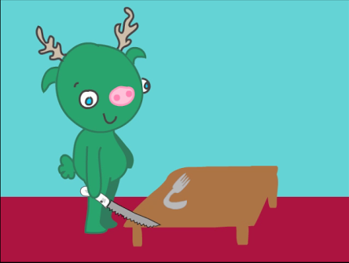
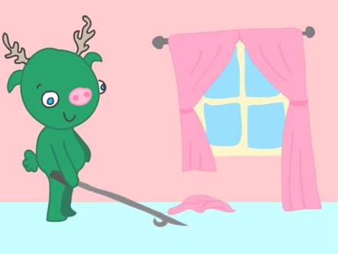
“The monster is going to blick the bread.”
“Which one is blicking?”

Slide 5
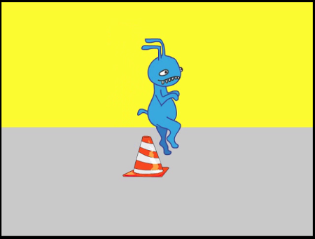
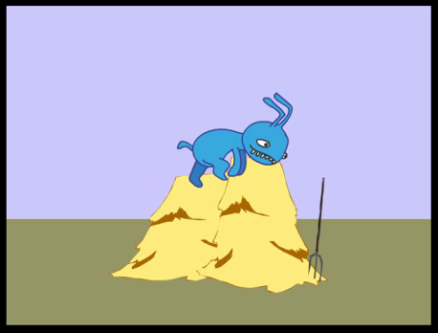
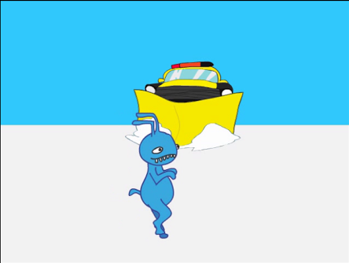
“The monster is going to burk over the cone.”
“Which one is burking?”

Slide 6
“She ran out of the room”.
verb phrase
(manner)
prepositional phrase
(path)

Slide 7
“She left the room running”.
verb phrase
(path)
prepositional phrase
(manner)

